Slide 1
Java Programming

Slide 2
Java basics
Case Sensitivity - Java is case sensitive, which means identifier Hello and hello would have different meaning in Java.
Class Names - For all class names the first letter should be in Upper Case. If several words are used to form a name of the class, each inner word's first letter should be in Upper Case. Example class MyFirstJavaClass
Method Names - All method names should start with a Lower Case letter. If several words are used to form the name of the method, then each inner word's first letter should be in Upper Case. Example public void myMethodName()
Program File Name - Name of the program file should exactly match the class name. When saving the file, you should save it using the class name (Remember Java is case sensitive) and append '.java' to the end of the name (if the file name and the class name do not match your program will not compile). Example : Assume 'MyFirstJavaProgram' is the class name. Then the file should be saved as'MyFirstJavaProgram.java'
public static void main(String args[]) - Java program processing starts from the main() method which is a mandatory part of every Java program..

Slide 3
Naming conventions in java
Name | Convention
class name | should start with uppercase letter and be a noun e.g. String, Color, Button, System, Thread etc.
interface name | should start with uppercase letter and be an adjective e.g. Runnable, Remote, ActionListener etc.
method name | should start with lowercase letter and be a verb e.g. actionPerformed(), main(), print(), println() etc.
variable name | should start with lowercase letter e.g. firstName, orderNumber etc.
package name | should be in lowercase letter e.g. java, lang, sql, util etc.
constants name | should be in uppercase letter. e.g. RED, YELLOW, MAX_PRIORITY etc.

Slide 4
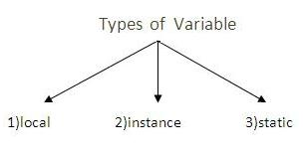
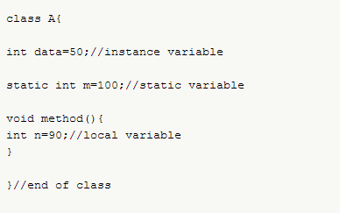
Variables
Variable is name of reserved area allocated in memory.
Identifier whose value will change during execution of the program.
Rules:
First letter must be an alphabet
Length can be upto 32 characters
No special characters allowed except underscore( _ )
No keyword to be used
A static variable is one that’s associated with a class, not objects of that class. Used in counting of objects
A instance variable is one associates with objects of that class.

Slide 5
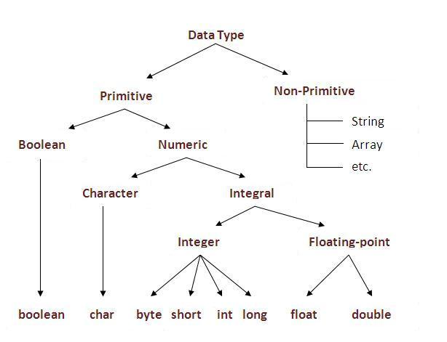
JAVA Data types
Data Type | Default Value | Default size
boolean | false | 1 bit
char | '\u0000' | 2 byte
byte | 0 | 1 byte
short | 0 | 2 byte
int | 0 | 4 byte
long | 0L | 8 byte
float | 0.0f | 4 byte
double | 0.0d | 8 byte
Range of any datatype = 2 (no of bits occupied by a particular datatype)

Slide 6
JAVA Data types
Primitive data types: These data types allow the variables to store only one value
Ex: double salary = 25350.75 ;
Note. For real constant value in float datatype, it takes 8 decimal places after dot(.) followed by ‘f’.
For real constant value in double datatype, it takes 8 decimal places after dot(.) not followed by ‘f’;
character is enclosed in ‘ ‘
Non-primitive or derived data types: These data types allow the variables to store multiple value of the same data type.
Data types:
Arrays
Ex: int a[] = {10,20,30,4,50};
Strings are enclosed in “ “
Ex: String printval = “Welcome”;
User defined data types: These are developed by programmers and whose variables allows to store multiple values either of the same type or different type or both.
Ex: classes, interfaces.

Slide 7
Unicode System
Unicode is a universal international standard character encoding that is capable of representing most of the world's written languages.
Before Unicode, there were many language standards:
ASCII (American Standard Code for Information Interchange) for the United States.
ISO 8859-1 for Western European Language.
KOI-8 for Russian.
GB18030 and BIG-5 for chinese, and so on.
This caused two problems:
A particular code value corresponds to different letters in the various language standards.
The encodings for languages with large character sets have variable length. Some common characters are encoded as single bytes, other require two or more byte.
To solve these problems, a new language standard was developed i.e. Unicode System.
In unicode, character holds 2 byte, so java also uses 2 byte for characters.
lowest value:\u0000 highest value:\uFFFF

Slide 8
Constants & Literals
Constants and literals are similar in that they cannot be changed.
A variable can be declared using the final keyword as a primitive data type that cannot change and is, thus, referred to as a constant.
A literal is a token such as 35 or 'c' which represents a value. Obviously, it cannot be modified either.
Related to this concept are immutable objects—objects which cannot be modified.
While the object cannot be modified, the reference variable pointing to the object can be changed

Slide 9
Literal Types
Numeric
Character
Strings

Slide 10
Numeric Literals
Numeric constants consist of a series of digits with an optional sign and an optional decimal point.
Numeric literals that contain a decimal point are by default double constants.
Numeric constants can also be prefixed with a 0x to indicate the number is a hexadecimal number (base 16).
Numbers that begin with a 0 are octal numbers (base 8).
A suffix of f or f can be used to declare a floating point literal as of type float .

Slide 11
Numeric literals
Java 7 added the ability to uses underscore characters ( _ ) in numeric literals.
long ssn = 111_22_3333l;
System.out.println(ssn);
The output is as follows:
111223333

Slide 12
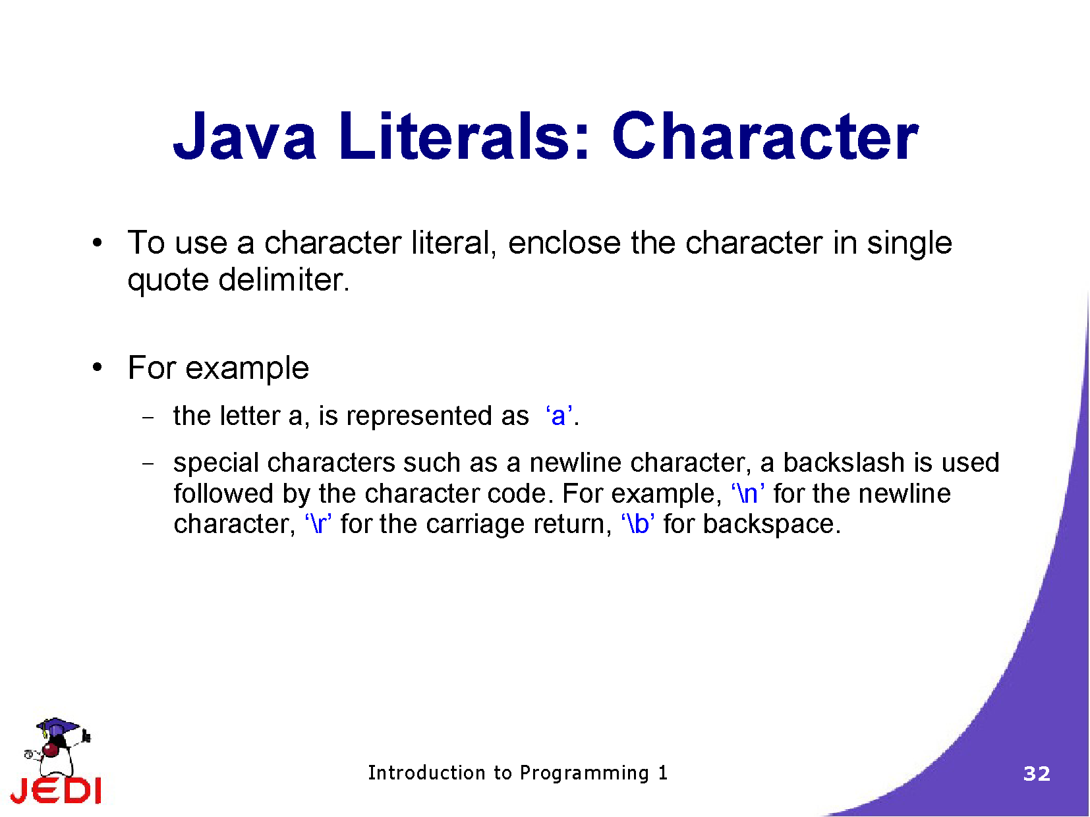
Character Literal

Slide 13
String Literal
String literals are a sequence of characters that are enclosed in a set of double quotes.
String literals cannot be split across two lines:
String errormessage = "error – bad input file name";
String columnheader = "\tcolumn 1\tcolumn2\n";

Slide 14
Java Constants
Constants are identifiers whose values cannot change. They are used in situations where, instead of using a literal, a more readable name should be used instead.
In java, constants are declared by prefixing the variable declaration with the final keyword.

Slide 15
Constants
These values cannot be changed:
final double PI = 3.14159;
final int NUMSHIPS = 120;
final float RATEOFRETURN = 0.125f;
In the following statement, an attempt is made to change the value of PI:
PI = 3.14;
Depending on the compiler, an error message similar to the following will be generated:
Cannot assign a value to final variable PI

Slide 16
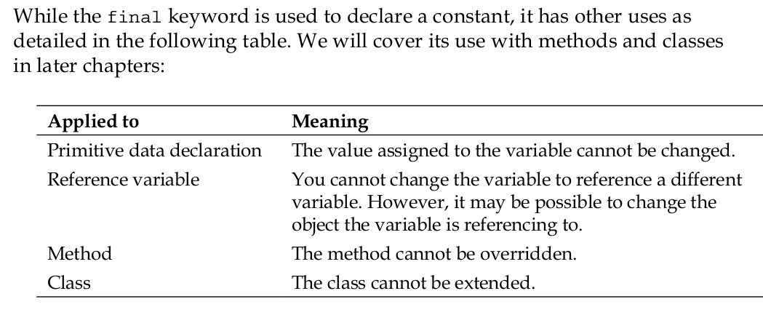
The Final Keyword

Slide 17
constants
A constant in Java is used to map an exact and unchanging value to a variable name.
Final variables are often declare with static keyword in java and treated as constant. Final keyword in variable declaration
Syntax: final datatype v₁ = val₁, v₂ = val₂,……v_{n} = val_{n};
Ex: public static final double PI = 3.14159;
Final keyword in method level
A java method with final keyword is called final method and it can not be overridden in sub-class. Syntax: final returntype methodname(list of formal parameters)
{
block of statements;
}
Final keyword in class level
Java class with final modifier is called final class in Java. Final class is complete in nature and can not be sub-classed or inherited
Several classes in Java are final e.g. String, Integer, Double and other wrapper classes. final class PersonalLoan{
}
class CheapPersonalLoan extends PersonalLoan { //compilation error: cannot inherit from final class
}
Final keyword allows JVM to optimized method, variable or class.
class PersonalLoan{
public final String getName(){
return "personal loan";
}
}
class CheapPersonalLoan extends PersonalLoan{
@Override
public final String getName(){
return "cheap personal loan"; //compilation error: overridden // method is final
}
}

Slide 18
Operators
Arithmetic Operators
Relational Operators
Bitwise Operators
Logical Operators
Misc Operators

Slide 19
Arithmetic
+ | Addition - Adds values on either side of the operator
- | Subtraction - Subtracts right hand operand from left hand operand
* | Multiplication - Multiplies values on either side of the operator
/ | Division - Divides left hand operand by right hand operand
% | Modulus - Divides left hand operand by right hand operand and returns remainder
++ | Increment - Increases the value of operand by 1
-- | Decrement - Decreases the value of operand by 1

Slide 20
Relational
== | Checks if the values of two operands are equal or not, if yes then condition becomes true.
!= | Checks if the values of two operands are equal or not, if values are not equal then condition becomes true.
> | Checks if the value of left operand is greater than the value of right operand, if yes then condition becomes true.
< | Checks if the value of left operand is less than the value of right operand, if yes then condition becomes true.
>= | Checks if the value of left operand is greater than or equal to the value of right operand, if yes then condition becomes true.
<= | Checks if the value of left operand is less than or equal to the value of right operand, if yes then condition becomes true.

Slide 21
Bitwise
& | Binary AND Operator copies a bit to the result if it exists in both operands.
| | Binary OR Operator copies a bit if it exists in either operand.
^ | Binary XOR Operator copies the bit if it is set in one operand but not both.
~ | Binary Ones Complement Operator is unary and has the effect of 'flipping' bits.
<< | Binary Left Shift Operator. The left operands value is moved left by the number of bits specified by the right operand.(<< 1 =multiply by 2)
>> | Binary Right Shift Operator. The left operands value is moved right by the number of bits specified by the right operand.(>> 1= divide by 2)
>>> | Bitwise zero fill right shift operator. The left operands value is moved right by the number of bits specified by the right operand and always fills 0

Slide 22
Logical
&& | Called Logical AND operator. If both the operands are non-zero, then the condition becomes true.
|| | Called Logical OR Operator. If any of the two operands are non-zero, then the condition becomes true.
! | Called Logical NOT Operator. Use to reverses the logical state of its operand. If a condition is true then Logical NOT operator will make false.

Slide 23
Misc operator
Conditional operator: This operator consists of three operands and is used to evaluate Boolean expressions. Ex:
variable x = (expression) ? value if true : value if false
instanceOf operator: This operator checks whether the object is of a particular type(class type or interface type)
String s="hello";
if( s instanceof String)
System.out.println("s is string");

Slide 24
Operators
Precedence of Operators
Operators | Precedence
postfix | expr++ expr--
unary | ++expr --expr +expr -expr ~ !
multiplicative | * / %
additive | + -
shift | << >> >>>
relational | < > <= >= instanceof
equality | == !=
bitwise AND | &
bitwise exclusive OR | ^
bitwise inclusive OR | |
logical AND | &&
logical OR | ||
ternary | ? :
assignment | = += -= *= /= %= &= ^= |= <<= >>= >>>=

Slide 25
Java keywords
abstract | assert | boolean | break
byte | case | catch | char
class | const | continue | default
do | double | else | enum
extends | final | finally | float
for | goto | if | implements
import | instanceof | int | interface
long | native | new | package
private | protected | public | return
short | static | strictfp | super
switch | synchronized | this | throw
throws | transient | try | void
volatile | while
JAVA comments :
single line use //
multiple lines /*….*/

Slide 26
Control statements
if(Boolean_expression) {
//Statements will execute if the Boolean expression is true
}
else if(Boolean_expression) {
//Statements will execute if the Boolean expression is true
}
else{
}

Slide 27
Switch
switch(expression){
case value :
//Statements
break; //optional
case value :
//Statements
break; //optional
default : //Optional
//Statements
}

Slide 28
Switch Example with String
public class switchstringexample {
public static void main(string[] args) {
printcolorusingswitch("red");
printcolorusingif("red");
// switch case string is case sensitive
printcolorusingswitch("red");
printcolorusingswitch(null);
}
private static void printcolorusingif(string color) {
if (color.equals("blue")) {
system.out.println("blue");
} else if (color.equals("red")) {
system.out.println("red");
} else {
system.out.println("invalid color code");
}
}
private static void printcolorusingswitch(string color) {
switch (color) {
case "blue":
system.out.println("blue");
break;
case "red":
system.out.println("red");
break;
default:
system.out.println("invalid color code");
}
}
}

Slide 29
Rules for switch
The variable used in a switch statement can only be a byte, short, int, or char.(String also after java 7)
Any number of case statements within a switch. Each case is followed by the value to be compared to and a colon.
The statements are followed by a optional break statement
When a break statement is reached, the switch terminates, and the flow of control jumps to the next line following the switch statement.
If no break appears, the flow of control will fall through to subsequent cases until a break is reached.
A switch statement can have an optional default case, which must appear at the end of the switch.
The default case can be used for performing a task when none of the cases is true. No break is needed in the default case.

Slide 30
Loop controlling
while loops
while(Boolean_expression) {
//Statements
}
do while loops
do {
//Statements
}while(Boolean_expression);

Slide 31
for loops
Normal :
for(initialization; Boolean_expression; update) {
//Statements
}
int arr[]={1,2,3};
for(int i=0;i<n;i++)
SOP(arr[i]);
Enhanced for java: (java SE5 onwards)
for(declaration : expression) {
//Statements
}
for(int i : arr)
SOP(i);

Slide 32
Important keywords
break
The break keyword is used to stop the entire loop.
The break keyword can be used inside any loop or a switch statement.
Continue
It causes the loop to immediately jump to the next iteration of the loop.
In a for loop, the continue keyword causes flow of control to immediately jump to the update statement.
In a while loop or do/while loop, flow of control immediately jumps to the Boolean expression.

Slide 33
Scanner class
Scanner is the best way to read input from key board
Scanner class breaks the input into tokens using a delimiter which is whitespace by default.

Slide 34
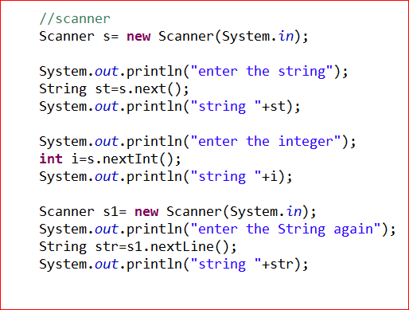
Reading Inputs From Keyboard

